Slide 1


<Name>
<Date>

Slide 2

Outline
Executive Summary
Introduction
Methodology
Results
Conclusion
Appendix

Slide 3
Executive Summary
The goal of this project was to develop a model to predict whether a Falcon 9 first stage will successfully land after launch. This way we can get better mission planning and cost estimation and reduce costs.
We had historical launch data and through exploratory data analysis we noticed launch success was highly correlated with features like mass of the payload, the orbit, launch site, the version of the booster being used, if parts were reused...
We applied several classification models and evaluated their performances. In particular, we evaluated logistic regression, support vector machines, decision trees and K-nearest neighbours. All four methods have similar high performance.
This high performance across all 4 methods prove launch success can be predicted accurately based our available data. Therefore, data science can be applied to decision making in this case to reduce rocket launches costs

Slide 4
Introduction
SpaceX disrupted the space launch market by changing cost structures and operational paradigms. At the forefront of these savings is Space X ability to reuse the first stage of Falcon 9 rockets.
Therefore, predicting if a first stage will land successfully after launch would become a very competitive advantage that will helps us reduce costs.

Slide 5

Section 1

Slide 6
Methodology
Executive Summary
Data collection methodology:
Data was collected from multiple open-access sources: the SpaceX REST API and Wikipedia. A dataset was compiled which provides information on launch dates, launch sites, payload characteristics, booster versions, reuse status, orbit types, and landing outcomes.
Perform data wrangling
All rows with missing data were removed and one hot encoding was applied to non-numerical fields.
Perform exploratory data analysis (EDA) using visualization and SQL
Perform interactive visual analytics using Folium and Plotly Dash
Perform predictive analysis using classification models
How to build, tune, evaluate classification models

Slide 7
Data Collection
We used two different sources:
Space X REST API: Historical information about Space X Falcon 9 launches including coordinates of launch, payload, orbit…
Wikpedia: Web scraping to collect Falcon 9 historical launch records

Slide 8
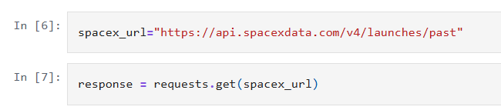
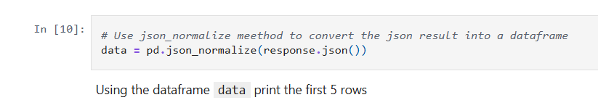
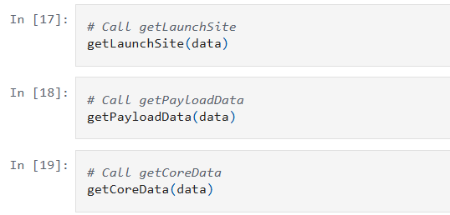
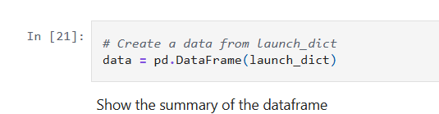
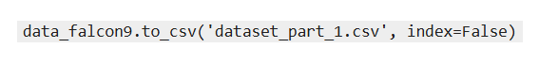
Data Collection – SpaceX API
Request to API
2. Conversion to JSON
3. Apply custom functions to format data
4. Build dataframe with new dataset
Source: https://github.com/AntoData/IBM_capstone_project/blob/main/Module%201%20-%20Introduction/5.%20jupyter-labs-spacex-data-collection-api.ipynb
5. Save dataset as text file

Slide 9
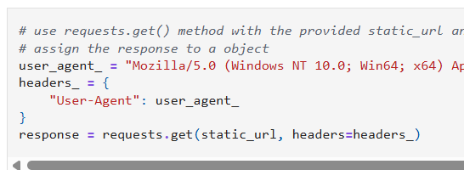
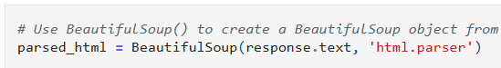
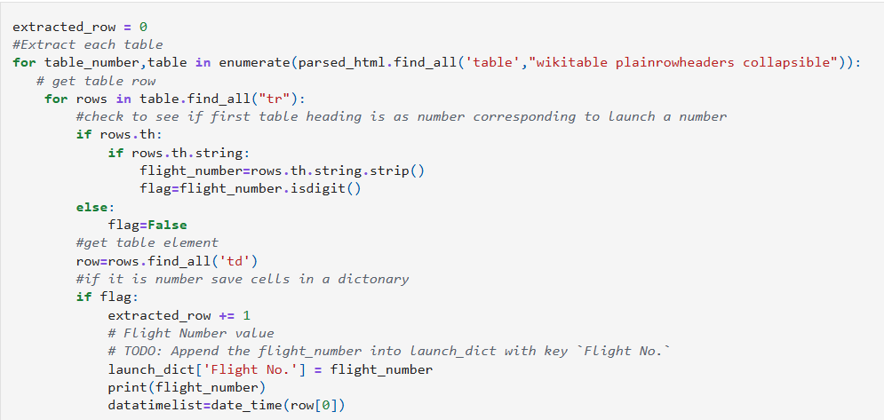
Data Collection - Scraping
Get request to wikipedia page
2. Create BeautifulSoup HTML parser
3. Parse HTML into data structures
4. Create dataframe
5. Save dataframe to text file
Source. https://github.com/AntoData/IBM_capstone_project/blob/main/Module%201%20-%20Introduction/6.%20jupyter-labs-webscraping.ipynb

Slide 10
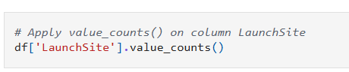
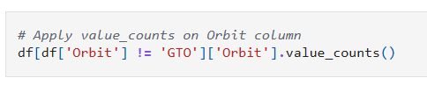
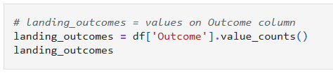
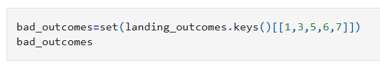
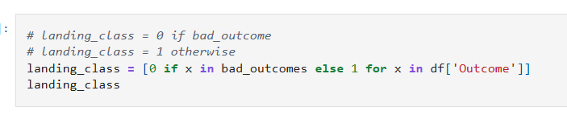
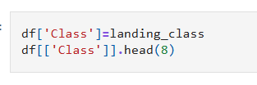
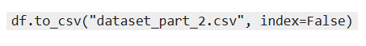
Data Wrangling
Get number of instances per Launch Site
2. Get number of launches whose orbit is not GTO
3. Store landing outcomes from the dataset
4. Classify landings into successful/failure
5. Create column in dataset for this flag
6. Save to text file
Source: https://github.com/AntoData/IBM_capstone_project/blob/main/Module%201%20-%20Introduction/8.%20labs-jupyter-spacex-Data%20wrangling.ipynb

Slide 11
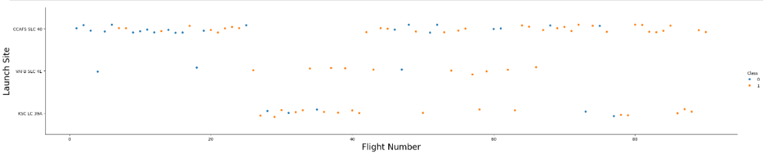
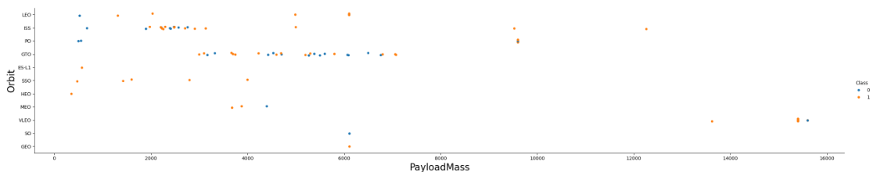
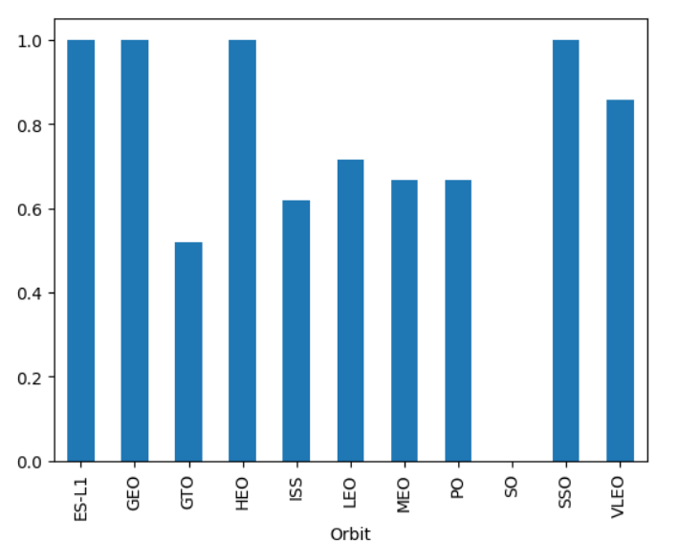
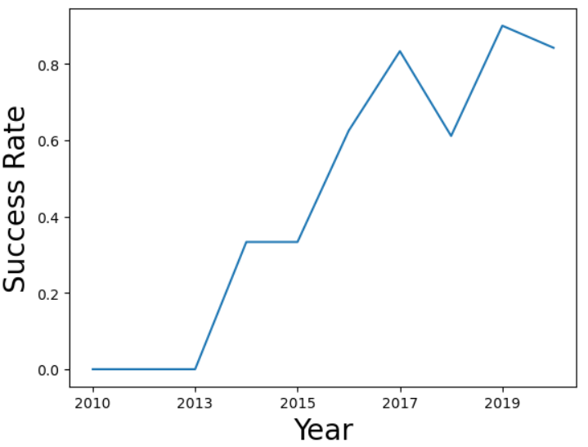
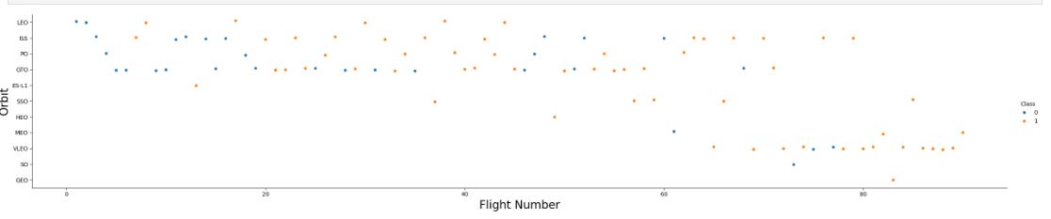
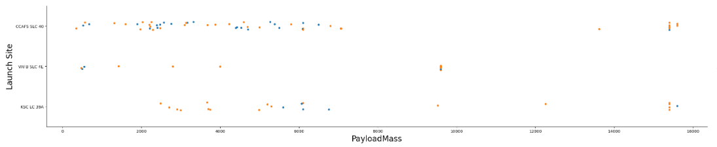
EDA with Data Visualization
Flight numbers vs launch site: Flight numbers are almost perfectly synched so several close launches are done within the same launch site
Payload Mass Vs. Launch Site: To realise the correlation between payload mass and launch site. For instance: For VAFB-SLC launchsite there are no rockets launched for heavypayload mass(greater than 10000).
FlightNumber vs Orbit type: You can observe that in the LEO orbit, success seems to be related to the number of flights
Success rate by orbit: To check if there is correlation between the orbit type and the success rate
Success rate evolution through the years: To check if there has been a positive evolution
Payload Mass vs Orbit type: With heavy payloads the successful landing or positive landing rate are more for Polar,LEO and ISS.
Source: https://github.com/AntoData/IBM_capstone_project/blob/main/Module%202%20-%20Exploratory%20Data%20Analysis%20(EDA)/3.%20edadataviz.ipynb

Slide 12
EDA with SQL
Get names of the unique launch sites in the space mission
Get 5 records where launch sites begin with the string 'CCA'
Get the total payload mass carried by boosters launched by NASA (CRS)
Get average payload mass carried by booster version F9 v1.1
Get the date when the first successful landing outcome in ground pad was achieved.
Get the names of the boosters which have success in drone ship and have payload mass greater than 4000 but less than 6000
Get the total number of successful and failure mission outcomes
Get all the booster_versions that have carried the maximum payload mass, using a subquery with a suitable aggregate function.
Get List the records which will display the month names, failure landing_outcomes in drone ship ,booster versions, launch_site for the months in year 2015.
Rank the count of landing outcomes (such as Failure (drone ship) or Success (ground pad)) between the date 2010-06-04 and 2017-03-20, in descending order.
Source: https://github.com/AntoData/IBM_capstone_project/blob/main/Module%202%20-%20Exploratory%20Data%20Analysis%20(EDA)/2.%20jupyter-labs-eda-sql-coursera_sqllite.ipynb

Slide 13
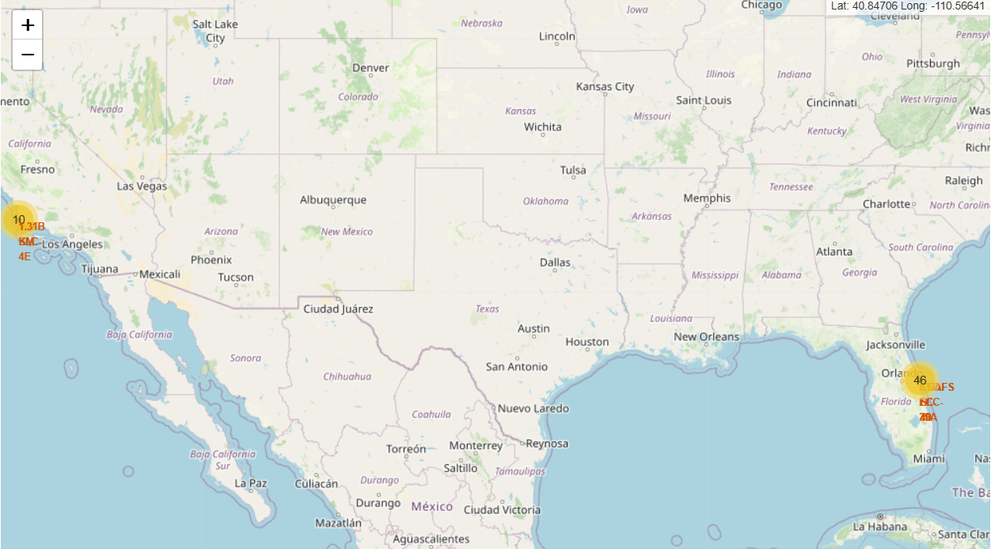
Build an Interactive Map with Folium
We created a map with circles to highlight the different launch sites and marker clusters to display the different launch attempts in each site with different colour depending on their result. Finally, we drew a line from one of the sites to the closest train rail.
The goal was to find an optimal location for our rocket launches
Source: https://github.com/AntoData/IBM_capstone_project/blob/main/Module%203%20-%20Interactive%20Visual%20Analytics%20and%20Dashboard/2.%20lab_jupyter_launch_site_location.ipynb

Slide 14
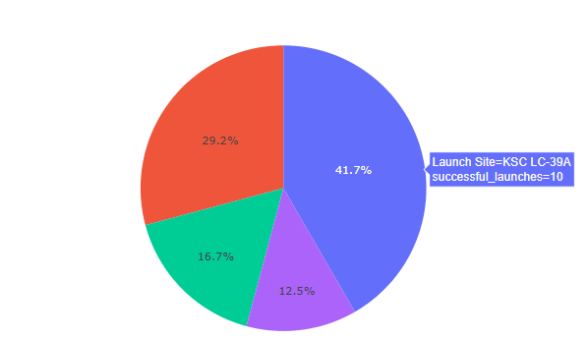
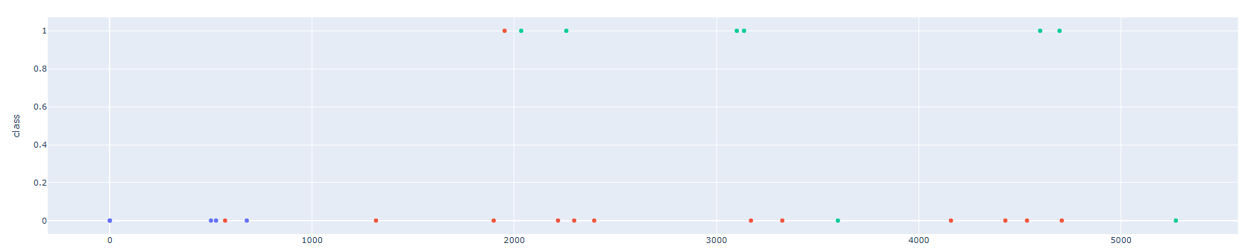
Build a Dashboard with Plotly Dash
Pie chart: Launch site vs success rate
If not particular launch site is selected: Percentage of successful launches in that site (vs other sites)
If a particular launch site is selected: Percentage of successful launches vs failures
Allows us to analyse the chances of success in each launch site
Scatter plot: X axis payload, y axis launch outcome
Dropdown allows to filter by launch site
Slider allows to filter by payload mass
The point color is the booster version
Allows to explore the different outcomes depending on launch site, payload mass and booster version

Slide 15
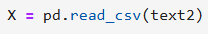
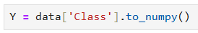
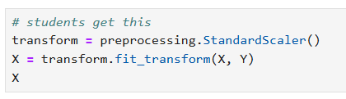
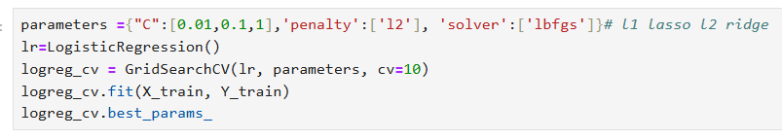
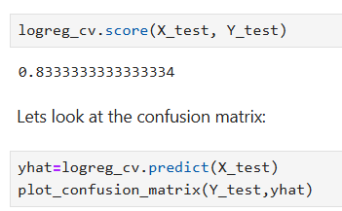
Predictive Analysis (Classification)
1, Define variables X and Y
2. Apply Standard Scaler
3. Split dataset into testing and training sets
4. For all 4 models: Logistic Regression., SVM, Decision Tree and KNN We create the model and apply GridSearchCV with certain parameters and train the mode to the parameters that provide the best modell
5. Get the accuracy score of the model over the testing set and confusion matrix
Source: https://github.com/AntoData/IBM_capstone_project/blob/main/Module%204%20-%20Predictive%20Analysis%20(Classification)/SpaceX_Machine%20Learning%20Prediction_Part_5.ipynb

Slide 16
Results
Logistic Regression, SVM, Decision Trees and KNN all perform similarly, their accuracy being around 83%
As time passes, success rates for launches increase
Orbits ES-L1, GEO, HEO, SSO have the highest success rate
For heavy payloads the successful landing rate is mostly for Polar, LEO and ISS.
For launch site VAFB-SLC there are no rockets launched for with a payload mass greater than 10000

Slide 17

Section 2

Slide 18
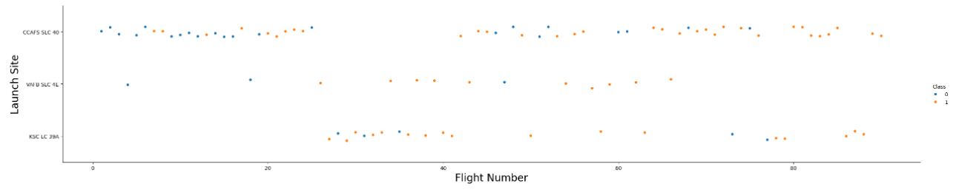
Flight Number vs. Launch Site
Flight numbers and launch sites are almost perfectly synched so several close launches are done within the same launch site. That means that if flight numbers are chronological, it looks like rocket launches happen in seasonally in each launch site. Probably due that a rocket launch usually includes several tests and more than one launch

Slide 19
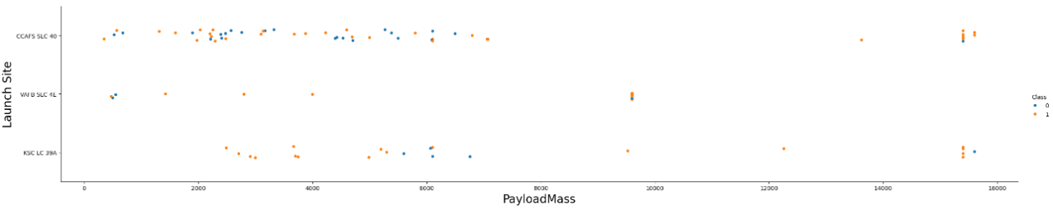
Payload vs. Launch Site
For launch site VAFB-SLC there are no rockets launched for heavypayload mass(greater than 10000).

Slide 20

Success Rate vs. Orbit Type
Orbits ES-L1, GEO, HEO, SSO have the highest success rate, 100%

Slide 21
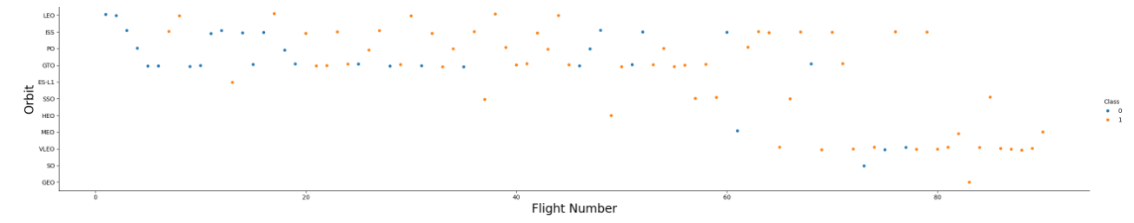
Flight Number vs. Orbit Type
In orbit of type LEO, success seems to be related to the flight numbers. Conversely, in the GTO orbit, there appears to be no relationship between flight number and success.

Slide 22
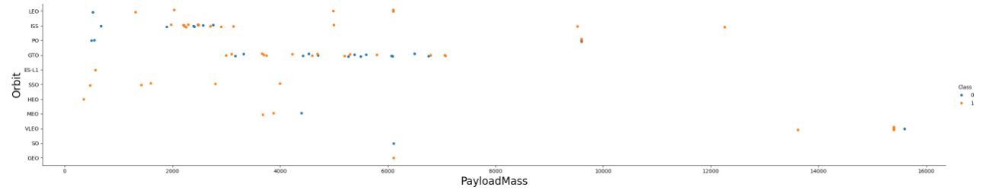
Payload vs. Orbit Type
For heavy payloads the successful landing or positive landing rates are higher for Polar,LEO and ISS.
However, for GTO, it's difficult to distinguish between successful and unsuccessful landings as both outcomes are present.

Slide 23
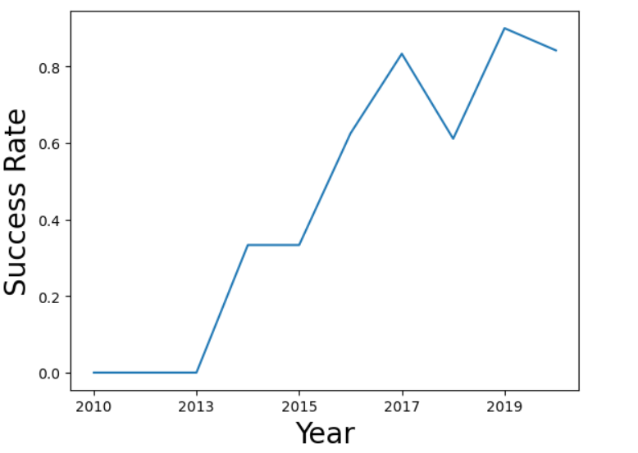
Launch Success Yearly Trend
Success rate since 2013 kept increasing till 2018 to increase again in 2019 with a final dive in 2020

Slide 24
All Launch Site Names
SELECT DISTINCT("Launch_Site") FROM SPACEXTABLE
CCAFS LC-40
VAFB SLC-4E
KSC LC-39A
CCAFS SLC-40

Slide 25
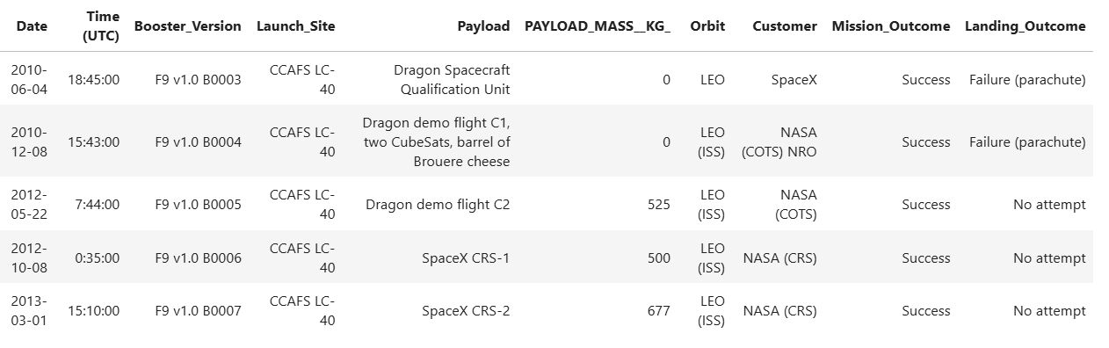
Launch Site Names Begin with 'CCA'

Slide 26
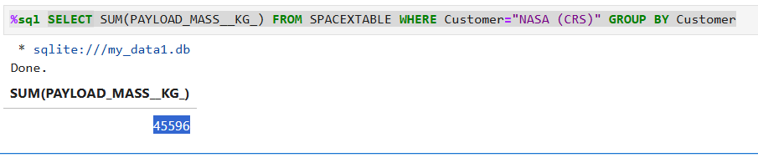
Total Payload Mass
SELECT SUM(PAYLOAD_MASS__KG_) FROM SPACEXTABLE WHERE Customer="NASA (CRS)" GROUP BY Customer
45596

Slide 27
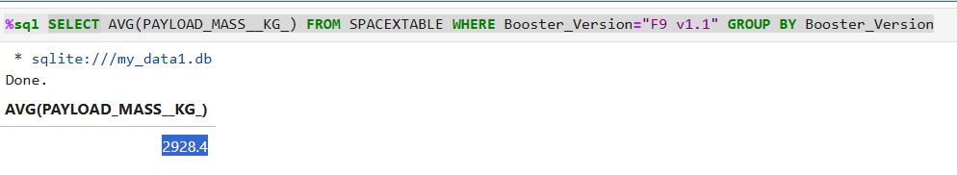
Average Payload Mass by F9 v1.1
SELECT AVG(PAYLOAD_MASS__KG_) FROM SPACEXTABLE WHERE Booster_Version="F9 v1.1" GROUP BY Booster_Version
2928.4

Slide 28
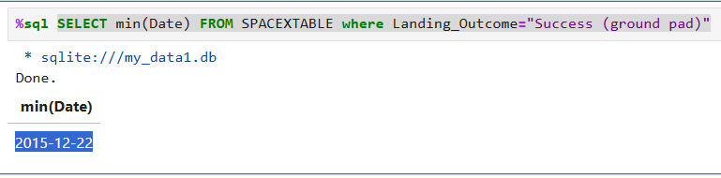
First Successful Ground Landing Date
SELECT min(Date) FROM SPACEXTABLE where Landing_Outcome="Success (ground pad)"
2015-12-22

Slide 29
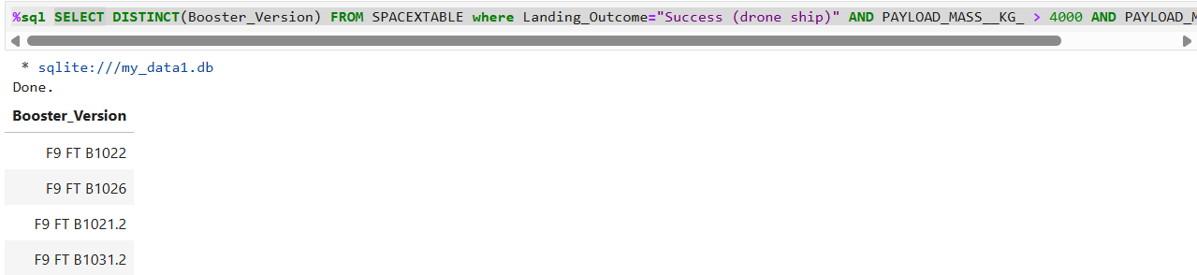
Successful Drone Ship Landing with Payload between 4000 and 6000
SELECT DISTINCT(Booster_Version) FROM SPACEXTABLE where Landing_Outcome="Success (drone ship)" AND PAYLOAD_MASS__KG_ > 4000 AND PAYLOAD_MASS__KG_ < 6000
F9 FT B1022
F9 FT B1026
F9 FT B1021.2
F9 FT B1031.2

Slide 30
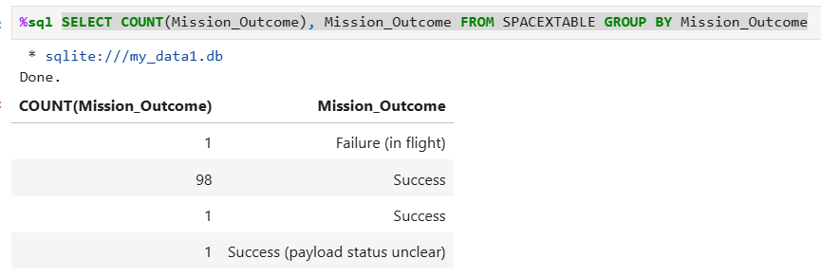
Total Number of Successful and Failure Mission Outcomes
SELECT COUNT(Mission_Outcome), Mission_Outcome FROM SPACEXTABLE GROUP BY Mission_Outcome
100 Success vs 1 Failure

Slide 31
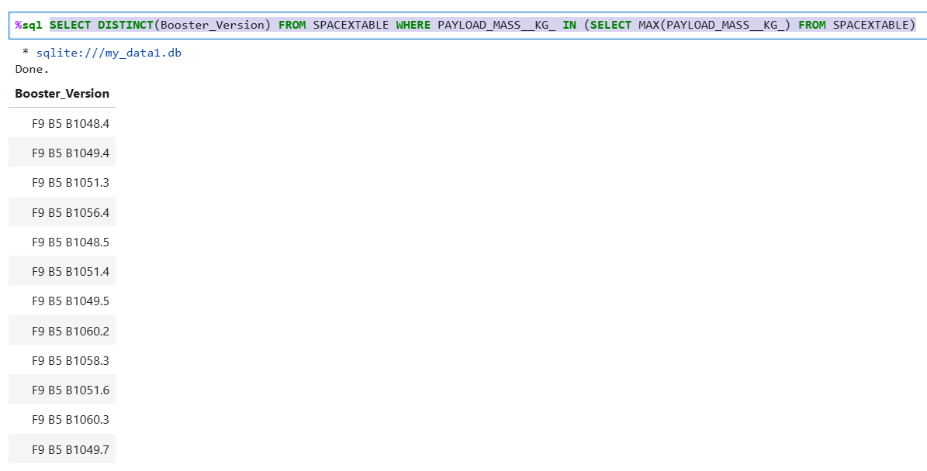
Boosters Carried Maximum Payload
SELECT DISTINCT(Booster_Version) FROM SPACEXTABLE WHERE PAYLOAD_MASS__KG_ IN (SELECT MAX(PAYLOAD_MASS__KG_) FROM SPACEXTABLE)

Slide 32
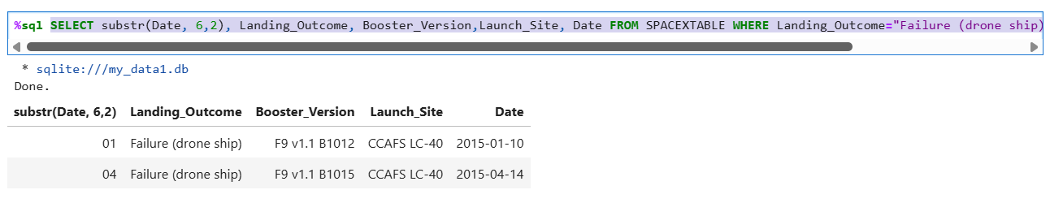
2015 Launch Records
SELECT substr(Date, 6,2), Landing_Outcome, Booster_Version,Launch_Site, Date FROM SPACEXTABLE WHERE Landing_Outcome="Failure (drone ship)" AND substr(Date,0,5)="2015"

Slide 33
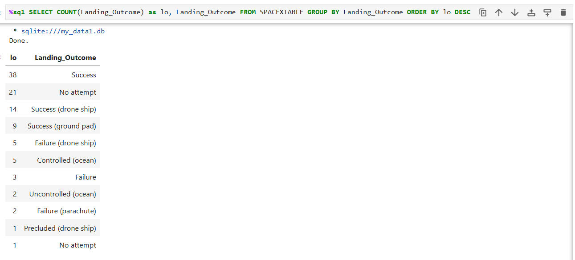
Rank Landing Outcomes Between 2010-06-04 and 2017-03-20
SELECT COUNT(Landing_Outcome) as lo, Landing_Outcome FROM SPACEXTABLE GROUP BY Landing_Outcome ORDER BY lo DESC

Slide 34

Section 3

Slide 35
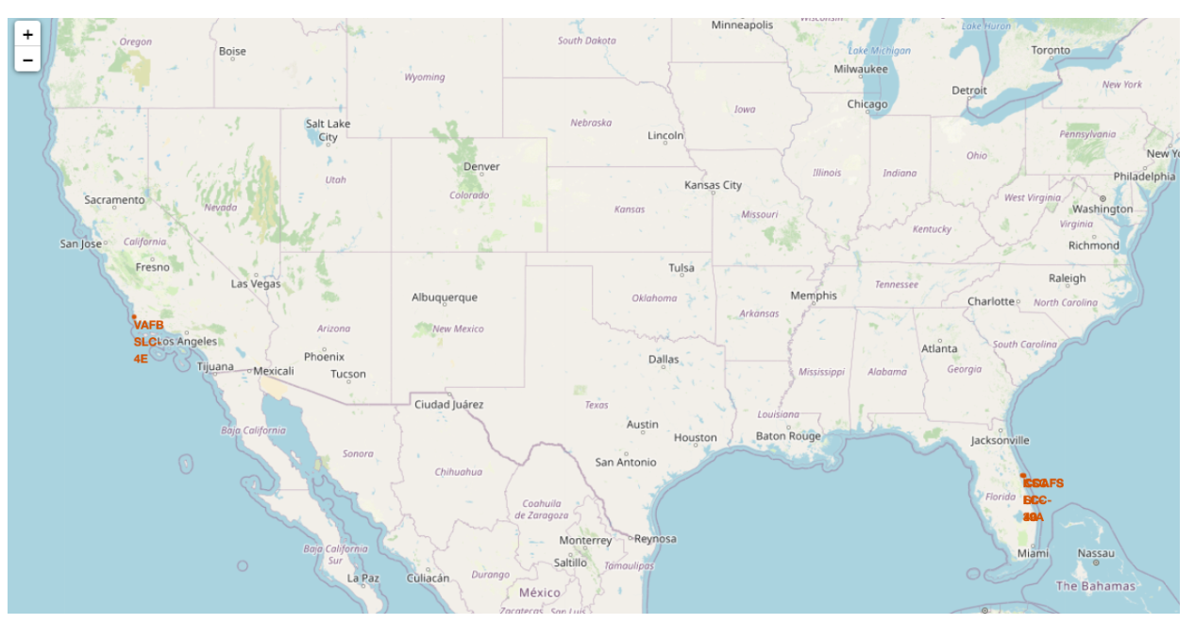
Launch sites on a map
The map contains all the launch site locations as orange circles

Slide 36
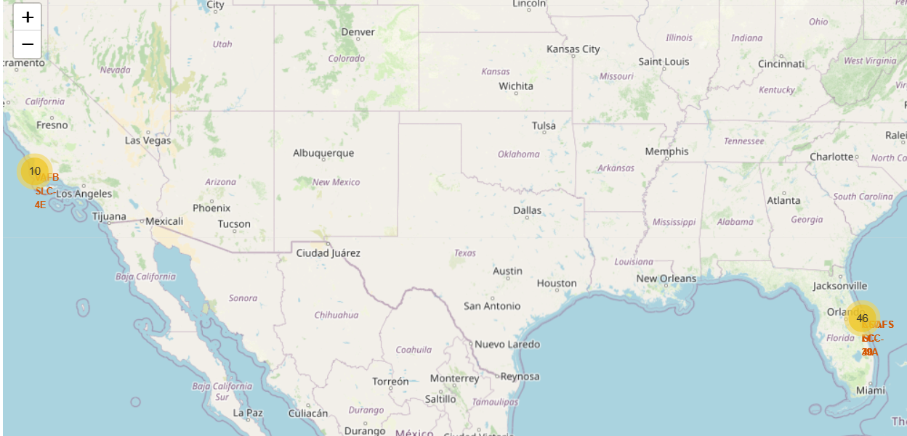
Success/failed launches per site
The map displays circles that return the number of launches in that area. Until we zoom to the location of a certain launch site and then we display the number of launches for that site only. When we select a circle in a launch site other markers are displayed in red to state failed launches and in green to display successful ones

Slide 37
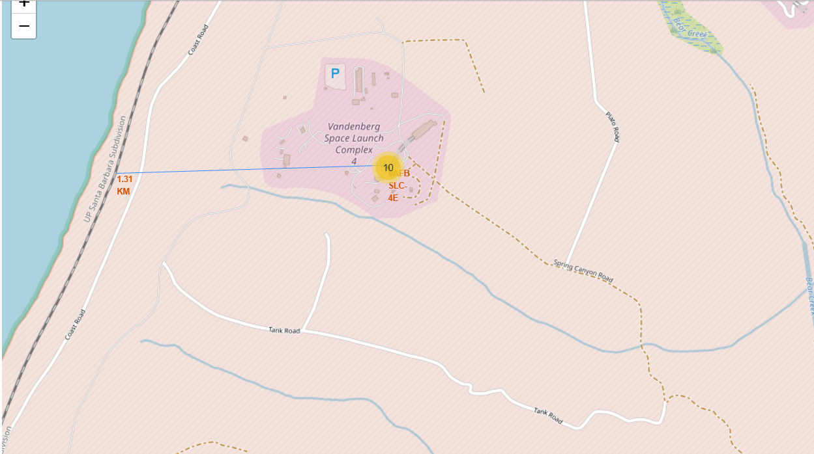
Distances between launch sites to its proximities
A line was drawn from a launch site in California to its closes railway

Slide 38

Section 4

Slide 39
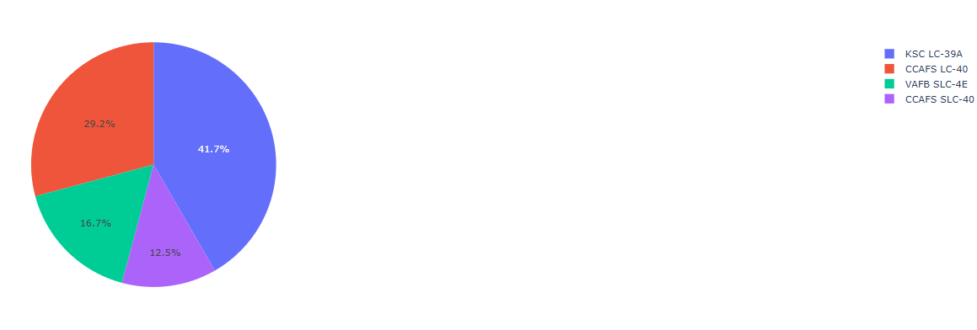
Launch site vs success rate
In this case no particular launch site is selected: Percentage of successful launches in that site (vs other sites) is displayed
Allows us to analyse the chances of success in each launch site

Slide 40
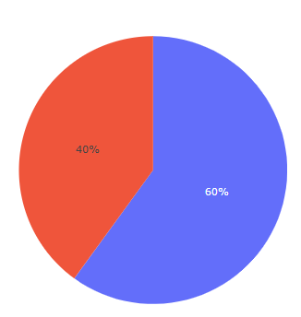
Success vs Failure rate in a launch site
In this case, a particular launch site was selected: Percentage of successful launches vs failures would is displayed
Allows us to analyse the chances of success in each launch site

Slide 41
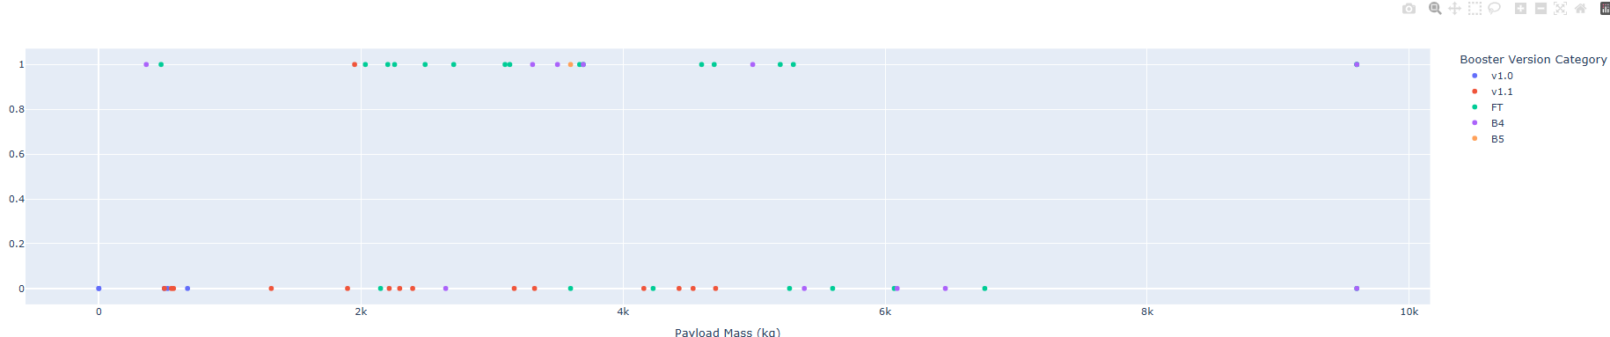
Payload vs Launch Outcome
Dropdown allows to filter by launch site
Slider allows to filter by payload mass
The point color is the booster version
Allows to explore the different outcomes depending on launch site, payload mass and booster version

Slide 42

Section 5

Slide 43
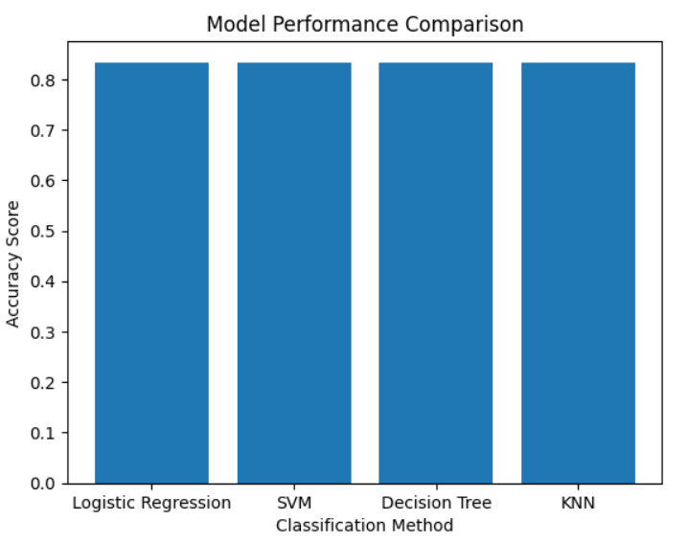
Classification Accuracy
All 4 models have the same accuracy score

Slide 44




Confusion Matrix
For all 4 models the performance and the confusion matrix are the same. We predict landings correctly but sometimes we predict launches where the first stage did not land properly as it had landed properly. We are a little biased to return false positives

Slide 45
Conclusions
All 4 models perform similarly to the point where their confusion matrixes are the same.
These models tend to predict successful launches with 100% accuracy, however they sometimes predict and successful launches instances where the first stage will not land properly
So we will be a little biased towards thinking launches will end with the first stage landing. Not allowing us to predict some cases where we will lose the first launch and therefore not being able to avoid it
As time passes, success rates for launches increase
Orbits ES-L1, GEO, HEO, SSO have the highest success rate
For heavy payloads the successful landing rate is higher for Polar, LEO and ISS.

Slide 46




Appendix
Best parameters for each model

Slide 47


